Slide 1
Module 2 project Automatic Door Sensor
MOPIDEVI VAISHNAVI

Slide 2
INTRODUCTION
It uses a detecting sensor when anyone open the door light will be on automatically in room. we can use this in future to send a message when the door is open when we are not in home . it’s useful for security purpose in homes. Its is useful in home security with the help of the project A door contact sensor is a peripheral security sensor that lets an lighting system know whether a door is opened or closed. When a door is opened, the sensor will activate and let the system know about the situation. The system will then respond based on the programming settings for that zone.

Slide 3
COMPONENTS
Atmega328p
LED
Voltage Meters
Switch
Power Source
Resistor

Slide 4
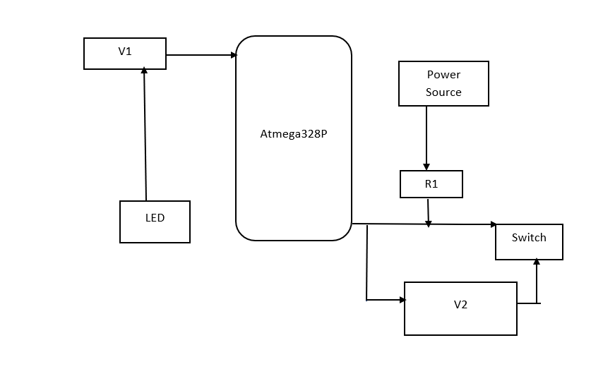
BLOCK DIAGRAM

Slide 5
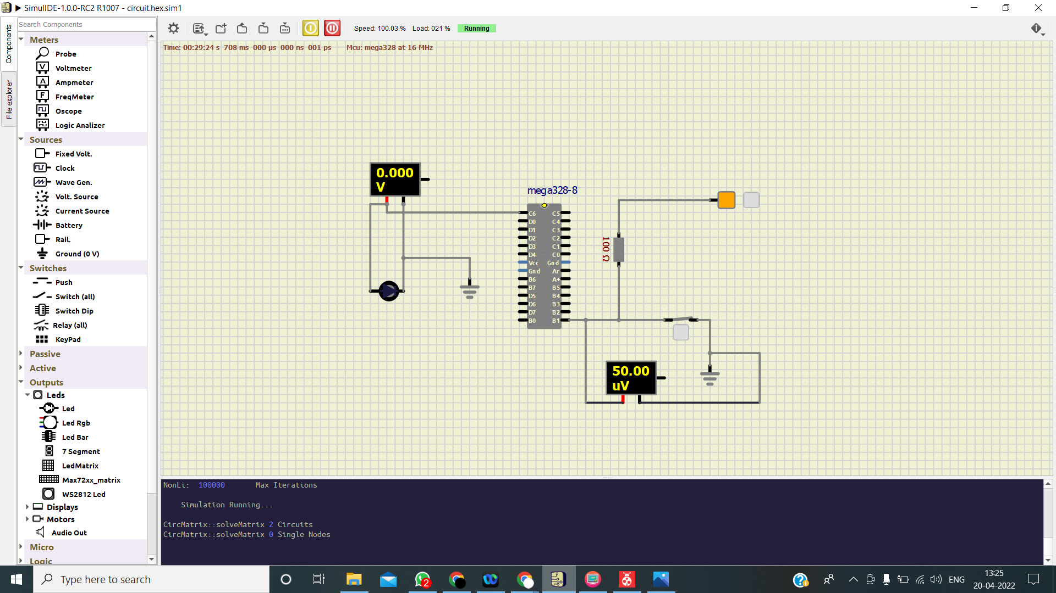
OUTPUT When Door is closed

Slide 6

When Door is Opened

Slide 7
CONCLUSION
Depending on the security system, you may be able to customize the type of alert you receive when a door opens. You may choose for an Light is ON when a door opens and You may choose for an Light is OFF when a door Closes.

